Slide 1
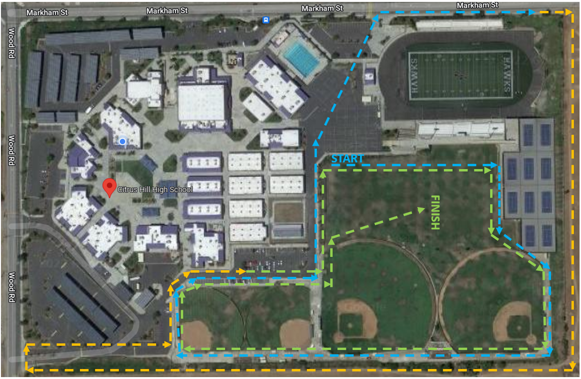

CITRUS HILL CROSS COUNTRY COURSE
MILE 1 – On Campus Start Times:
MILE 2 – Off Campus JV Girls 1:30pm, JV Boys 2:00pm MILE 3 – On Campus Var Girls 2:30pm, Var Boys 3:00pm

Slide 2


Stadium Restrooms in Use
DSO
Cattle Gates w/ Caution Tape Across Blacktop
DSO
Cattle Gate
Cones: Move after 1st Lap Around
Cattle Gate
CITRUS HILL CROSS COUNTRY COURSE
MILE 1 – On Campus Start Times:
MILE 2 – Off Campus JV Girls 1:30pm, JV Boys 2:00pm
MILE 3 – On Campus Var Girls 2:30pm, Var Boys 3:00pm

